Slide 1
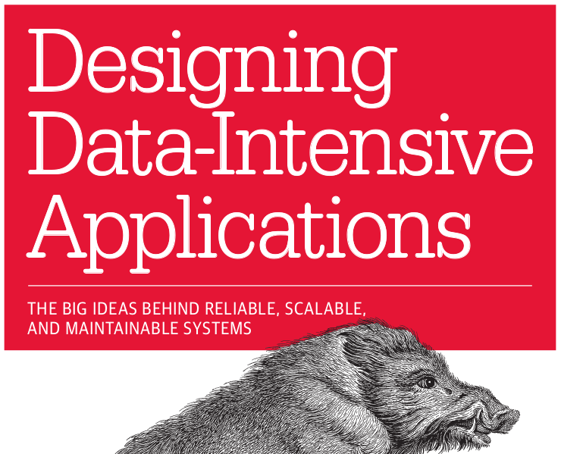
CHAPTER 1
RELIABLE
SCALABLE
MAINTAINABLE

Slide 2
Is yours a Data-Intensive use case?
An application is data intensive if the amount of data that it generates/uses increases quickly or if the complexity of data that it generates/uses increases quickly or if the speed of change in data increases quickly.

Slide 3
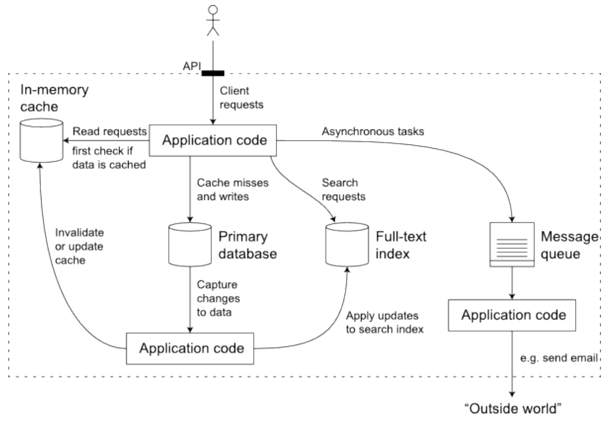
Components of data intensive app
Credit: Martin Kleppmann: Source https://www.semanticscholar.org/paper/Designing-Data-Intensive-Applications%3A-The-Big-and-Kleppmann/24f14e3b30012c2bc7e3abbdb16e2b3365d6f920

Slide 4
Main components in a data-intensive app:
Databases for source of truth for any consumer. E.g. Oracle/MySQL
Cache for temporarily storing an expensive operation to speed up reads. E.g. Memcache
Full-text Index for quickly searching data by keyword or filter.e.g. Apache Lucene
Message queues for messaging passing between process. E.g. Apache Kafka
Stream processing. E.g. Apache Samza, Apache Spark
Batch processing for crunching large amount of data. E.g. Apache Spark/Hadoop
Application code which acts as the connective tissue between the above components.

Slide 5
Role of an application developer is to design the data system for reliability, scalability and maintainability.

Slide 6
Reliability
Fault tolerance
No unauthorized access
Chaos testing
Full machine failures
Bugs - Automating tests
Staging/testing environment
Quickly roll-back

Slide 7
Scalability
Handle higher traffic volume
Traffic load with peak #of reads,writes and simultaneous users
Capacity planning
Response time vs throughput.
End user response time
90th,95th Percentile SLO/A service level objectives/agreements.
scaling up (more powerful machine)
scaling out (distributed many smaller machines).

Slide 8
Maintainability
Add new people to work
productivity
Operable: Configurable and testable
Simple: easy to understand and ramp up
Evolveable: easy to change

Slide 9
There is no one magic solution that works for all data-intensive application use cases. Your solution will be custom to your needs, as long as you have a good idea of the above three pillars of Reliability, Scalability and Maintainability you will build the right system.

Slide 10
CHAPTER 2
DATA MODELS & QUERY LANGUAGES

Slide 11
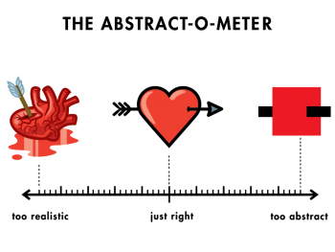

Slide 12
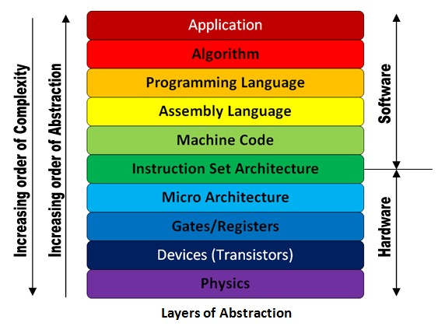

Slide 13
Data Abstraction
Data Structures
Application layer
1
Json
Api layer
2
Bytes Memory/Disk
3
Magnetic Fields Hardware
4

Slide 14


Model a social network
Users -> Friends -> Posts -> Likes
Notes:
Static type checking (schema on write db enforced), Dynamic type checking (schema on read app enforced).

Slide 15
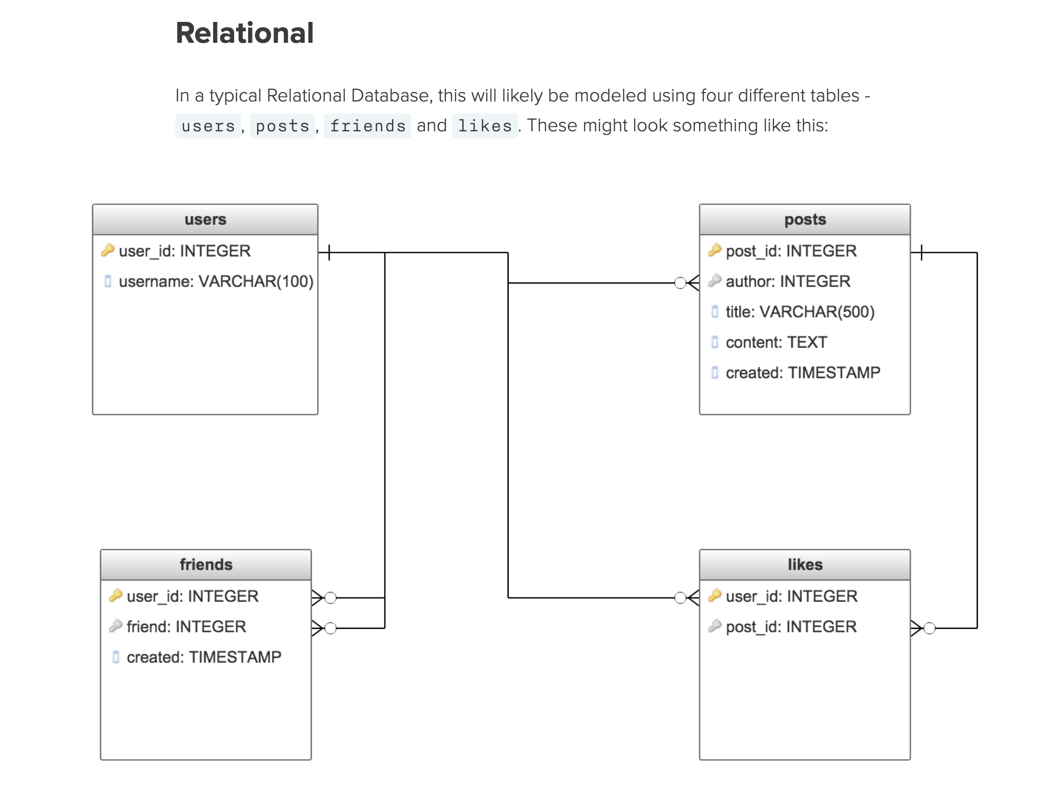
Relational model
Notes:
Static type checking (schema on write db enforced), Dynamic type checking (schema on read app enforced).

Slide 16
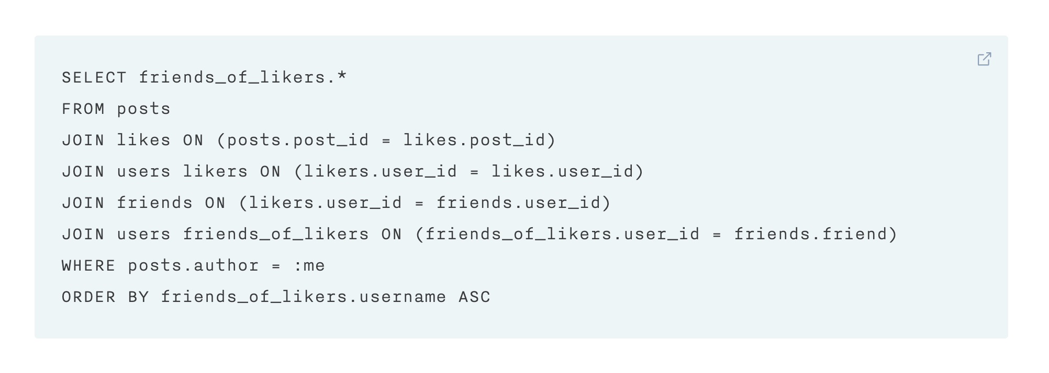
Relational query
Notes:
Static type checking (schema on write db enforced), Dynamic type checking (schema on read app enforced).

Slide 17
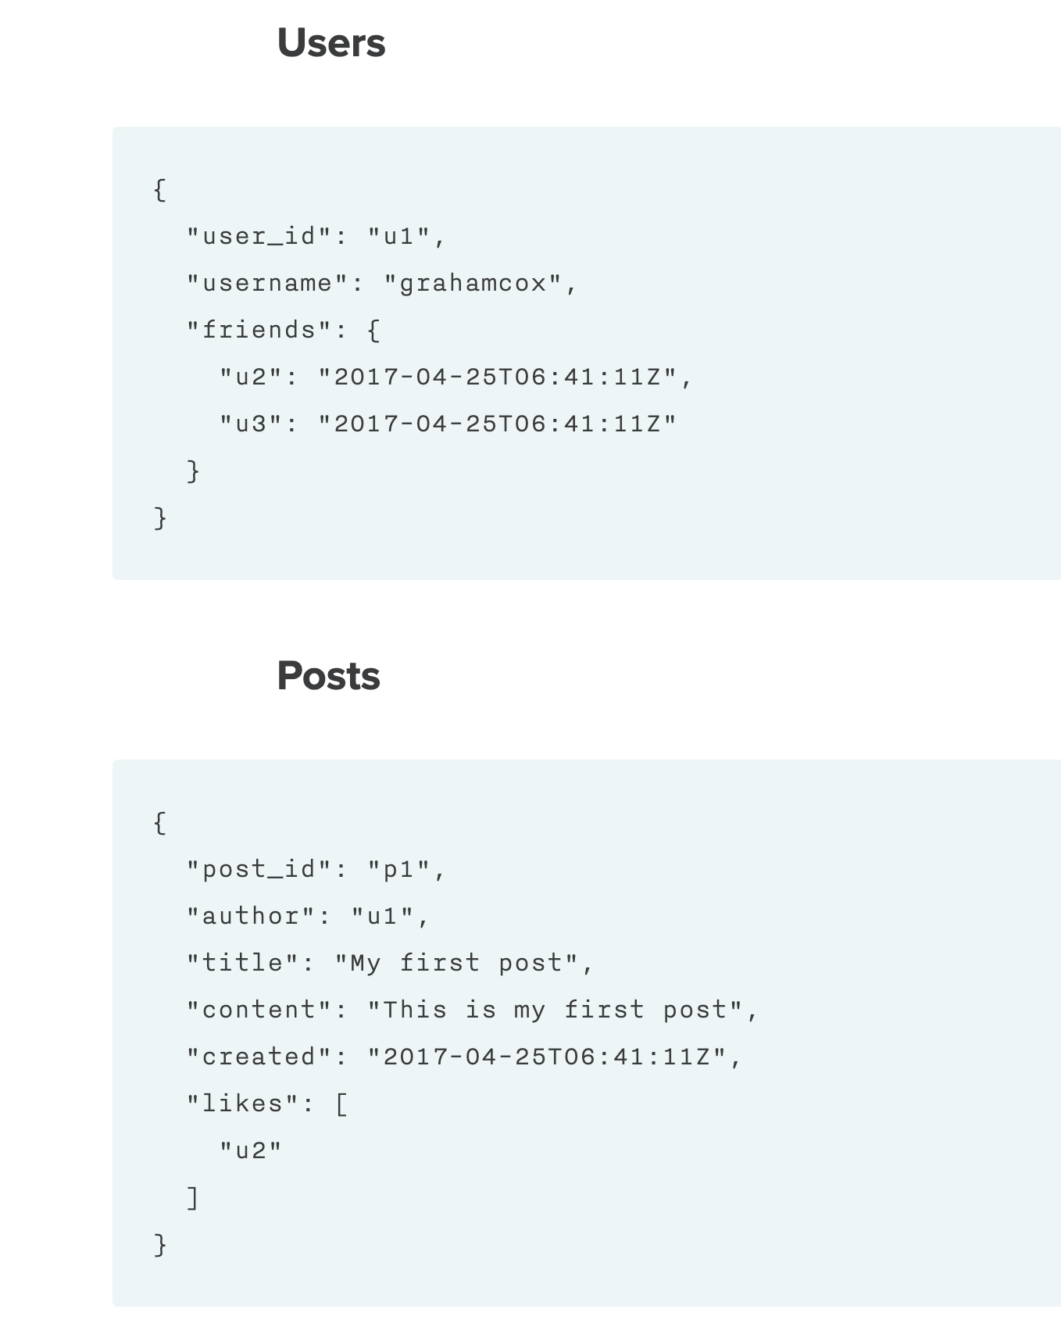
Document based model
Notes:
Static type checking (schema on write db enforced), Dynamic type checking (schema on read app enforced).

Slide 18
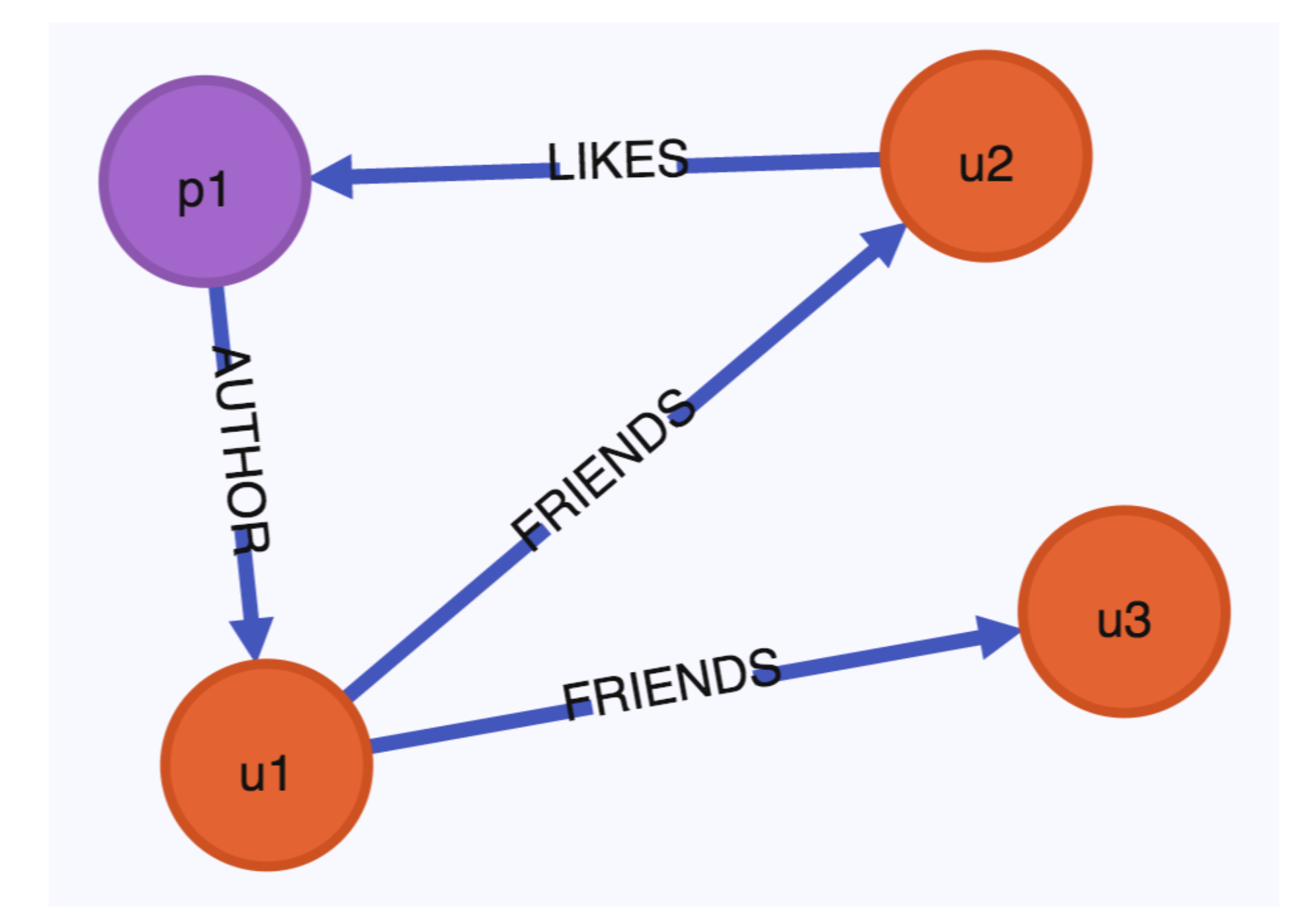
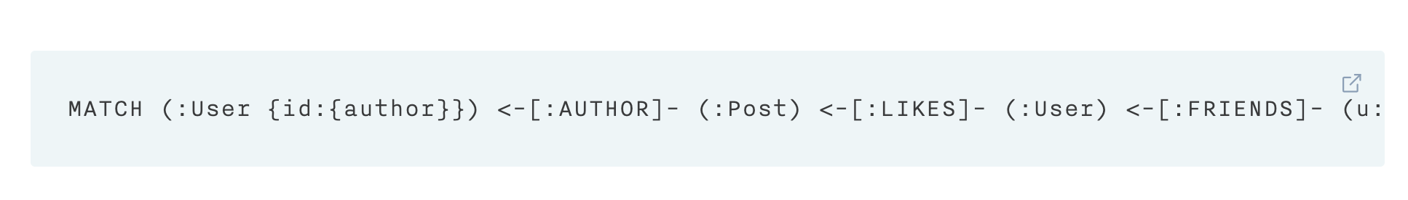
Graph model
Notes:
Static type checking (schema on write db enforced), Dynamic type checking (schema on read app enforced).

Slide 19
Data Storage and Data Retrieval are the two main things to consider. Same query can be either written in 4 lines or with 30 lines based on your data model!

Slide 20
3 Main categories of databases
01
Optimized for Transaction and batch processing (read throughput), joins..
Data organized as table/relations
Object Relational Mapping needed.
Oracle, MySQL, PostgreSQL..
Relational Database
02
NoSQL - Not only SQL.
Flexible schemas, better performance due to locality/High write throughput.
Mainly free and open source. (Espresso,CouchDB, MongoDB..)
Document Database
03
Best suited for highly interconnected data - many to many relationships.
Social graph, Web graph (Neo4j AnzoGraph, SPARQL, Cypher)
Graph Database
Notes:
A hybrid between relational and document models is a good route for databases to take in the future

Slide 21
Document databases target use cases where data comes in self-constrained documents and relationships between one document and another are rare.
Graph databases go in the opposite direction, targeting use cases where anything is potentially related to everything.
Notes:
Each data model comes with its own query language. Full text search, similarly search(DNA)..

Slide 22
Query languages
Imperative - e.g. SQL - tell exactly how to perform certain operation in a certain order.
SELECT * FROM animals WHERE family = ‘Sharks’
Declarative - e.g. CSS - just specify the pattern
Li.selected > p { background-color: blue; }
?map reduce?

Slide 23




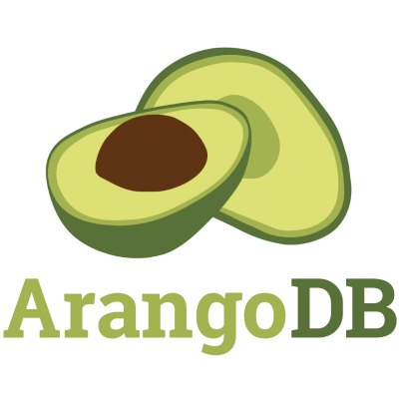


Slide 24
CHAPTER 3
STORAGE &
RETRIEVAL

Slide 25

Storage &
Retrieval

Slide 26
Which database to use ??
Every storage engine is optimized for different use cases. Select the right storage engine for your use case.
As an application developer we need to have a rough idea on what the storage engine is doing under the hood so that we can select the right one.
Tuning and optimizing pointers.

Slide 27
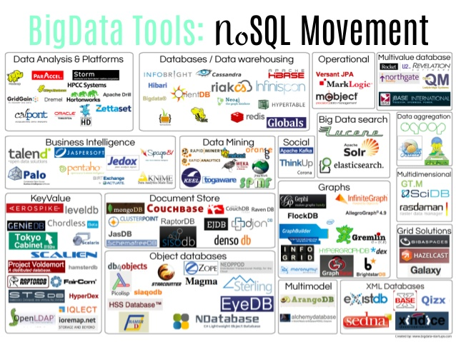

Slide 28
Which database to use ??
There are two broad categories of databases - OLTP and OLAP each with different read pattern, write patterns, user using it, data size etc.
OLTP - Online Transaction processing database are optimized for latency.
E.g. MySQL, Oracle.
OLAP - Online Analytical processing databases are optimized data crunching! Data Warehousing - Star/Snowflake schema, Column oriented! Column compression, Data Cubes, optimized for reads/queries. Materialized views. Lack of flexibility.
E.g. Hbase, Hive, Spark,

Slide 29
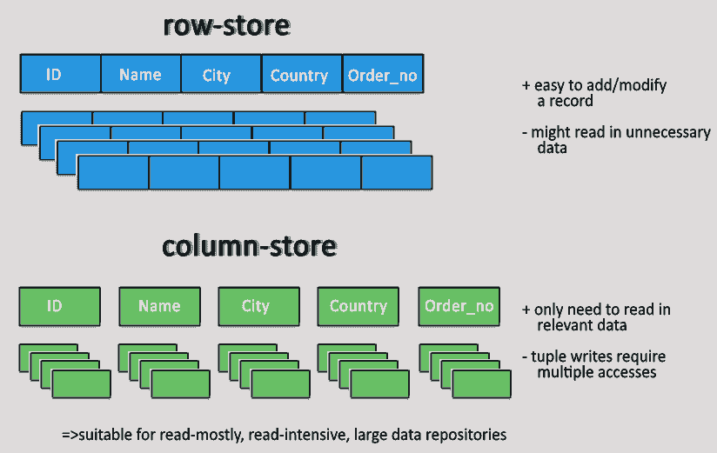

Slide 30
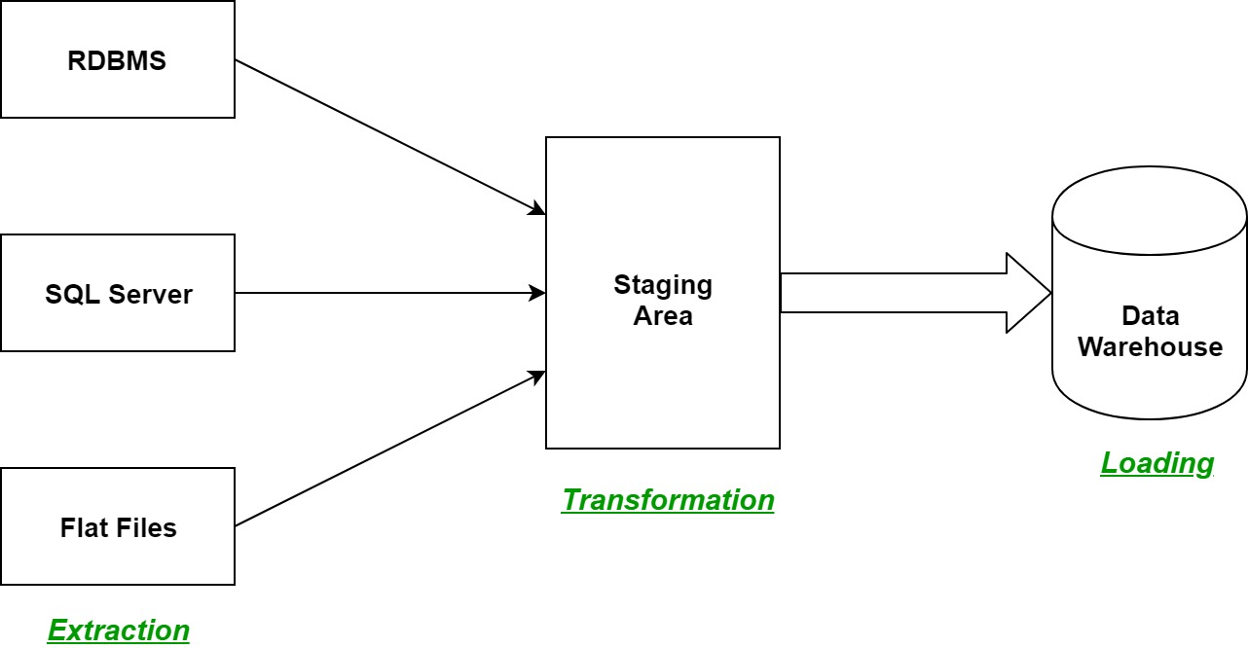

Slide 31
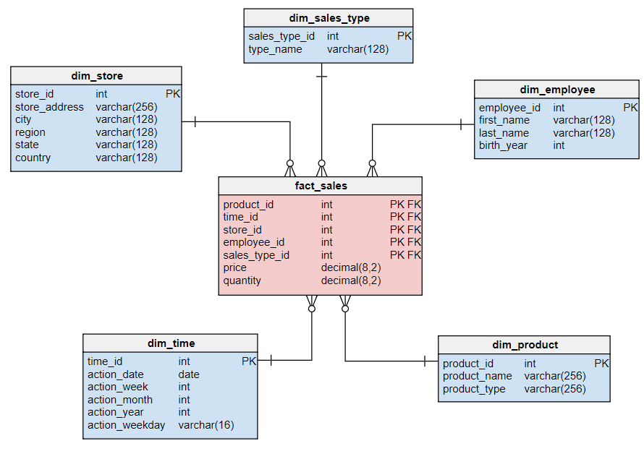

Slide 32
Database Index
An Index is an additional structure that is derived from the primary data. A well chosen index optimizes for reads but slows down the write. ← your use case?
Simple database index is a Hash based Index. Some issues for an index
File format (encoding)
Deleting records
Crash recovery
Partially written records
Concurrency control
Range queries?

Slide 33
Types of storage engines
There are two families of storage engines these databases use
Log-structured - LSM-Trees e.g. SSTables → HBase, Cassandra
Page-Oriented - B-trees. → RDBMS
These are answers to limitations of disk access.

Slide 34
LSM-Trees - Log Sort Merge
SSTables - Sorted String Tables
SSTables - in-memory mem table backed by Disk SSTable file, sorted by keys. E.g. Red-black tree or AVL Trees. Supports high wight throughput.
Lucene - full-text search is much more complex than key-value index like SSTables. It does internally use SSTables for term dictionary.
Bloom filters - memory-efficient data structure used for approximating the contents of a set. It can tell you if a key does not appear in the database, thus saves many unnecessary disk reads for nonexistent keys.
Compaction is a background process of the means of throwing away duplicate keys in the log and keeping only the most recent update for each key. LevelDB, RocksDB, Cassandra and HBase are examples that use LSM-Trees.

Slide 35
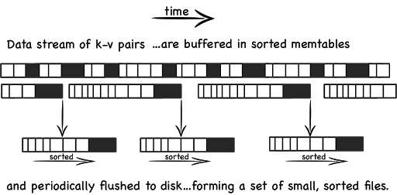
LSM-Trees - Log Sort Merge
SSTables - Sorted String Tables

Slide 36
B-Trees Index
Most widely used indexing structure is B-Trees. One place per key!
They are the standard implementation in RDBMS and NoSQL stores today.
It also keeps key-value sorted by keys which allows quick lookups.
B-Trees are designed and optimized for the hardware as disks are arranged in fixed-size blocks, B-Trees also break down the data into fixed size 4KB blocks
There is a root node and a branching factor (references to child pages).
4 level tree with 4KB pages with branching factor of 500 can store up to 256TB!! B-Tree is optimized for reads!
Write ahead log is used for Crash recovery, Latches for concurrency.
Sibling references in child node allows for easier scanning of sequential keys.

Slide 37
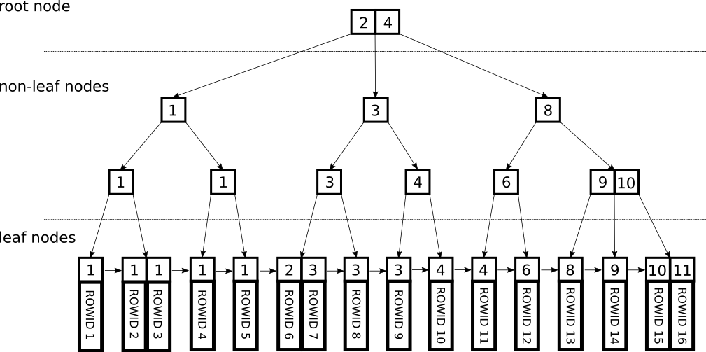
B-Trees Index

Slide 38
More about Index
Clustered index - inline storing of row values.
Secondary index - helps with joins.
Covering index - few columns are included.
Multi-column index - multiple keys concatenated.
Full-text search and fuzzy indexes help with spelling mistakes(edit-distances), grammar, synonyms, words near each other, linguistics etc.
In Memory stores - VoltDB, MemSQL,Memcached.

Slide 39
CHAPTER 4
Agile Code Evolution & Data Encoding

Slide 40
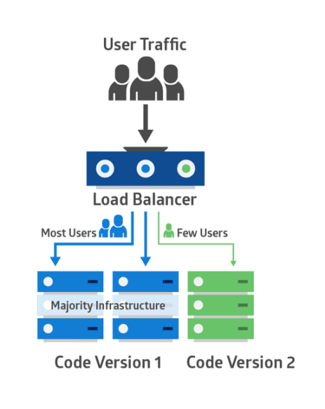
Rolling upgrade

Slide 41
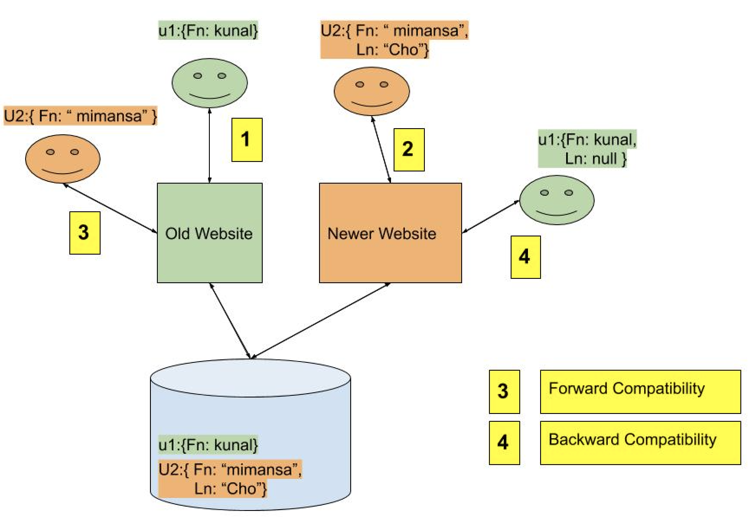
Code
Compatibility
Backward Compatibility: Newer code can read data that was written by older code for old and new clients.
Forward Compatibility: Older code can read data that was written by newer code for new and old clients.
Notes:
https://docs.google.com/drawings/d/1qCujJl4JxbJumeOiIo-xOQv8Y1luuwZL2D0F5ZbO-ew/edit

Slide 42
Encoding/Decoding
{ “username” : “kunalc”,
“favoriteNumber”: 1111,
“Interests”: [“kayaking”, “daydreaming”]
}
Encoding == Serialization == Marshalling.
Decoding == Deserialization == Unmarshalling.
Language specification formats - java.io.Serializable.
Text based - JSON, CSV, XML
Binary encoding - varying parse and size performance.
Text Json - 81 bytes, Binary JSON - 66 bytes, Thrift Binary - 59 bytes, Thrift Compat - 34 bytes, Protocol Buffer - 33 bytes, Avro - 32 bytes.
Notes:
Schema based

Slide 43
Data transfer use cases
Example data structure
{ “username” : “kunalc”,
“favoriteNumber”: 1111,
“Interests”: [“kayaking”, “daydreaming”]
}
To a File
To a Database
To an external service over the network - Rest.li(json/http), SOAP/WSDL, RPC
To an async server via message passing - one way communication/kakfa/rabbotmq/activeMQ

Slide 44
CHAPTER 5
REPLICATION

Slide 45
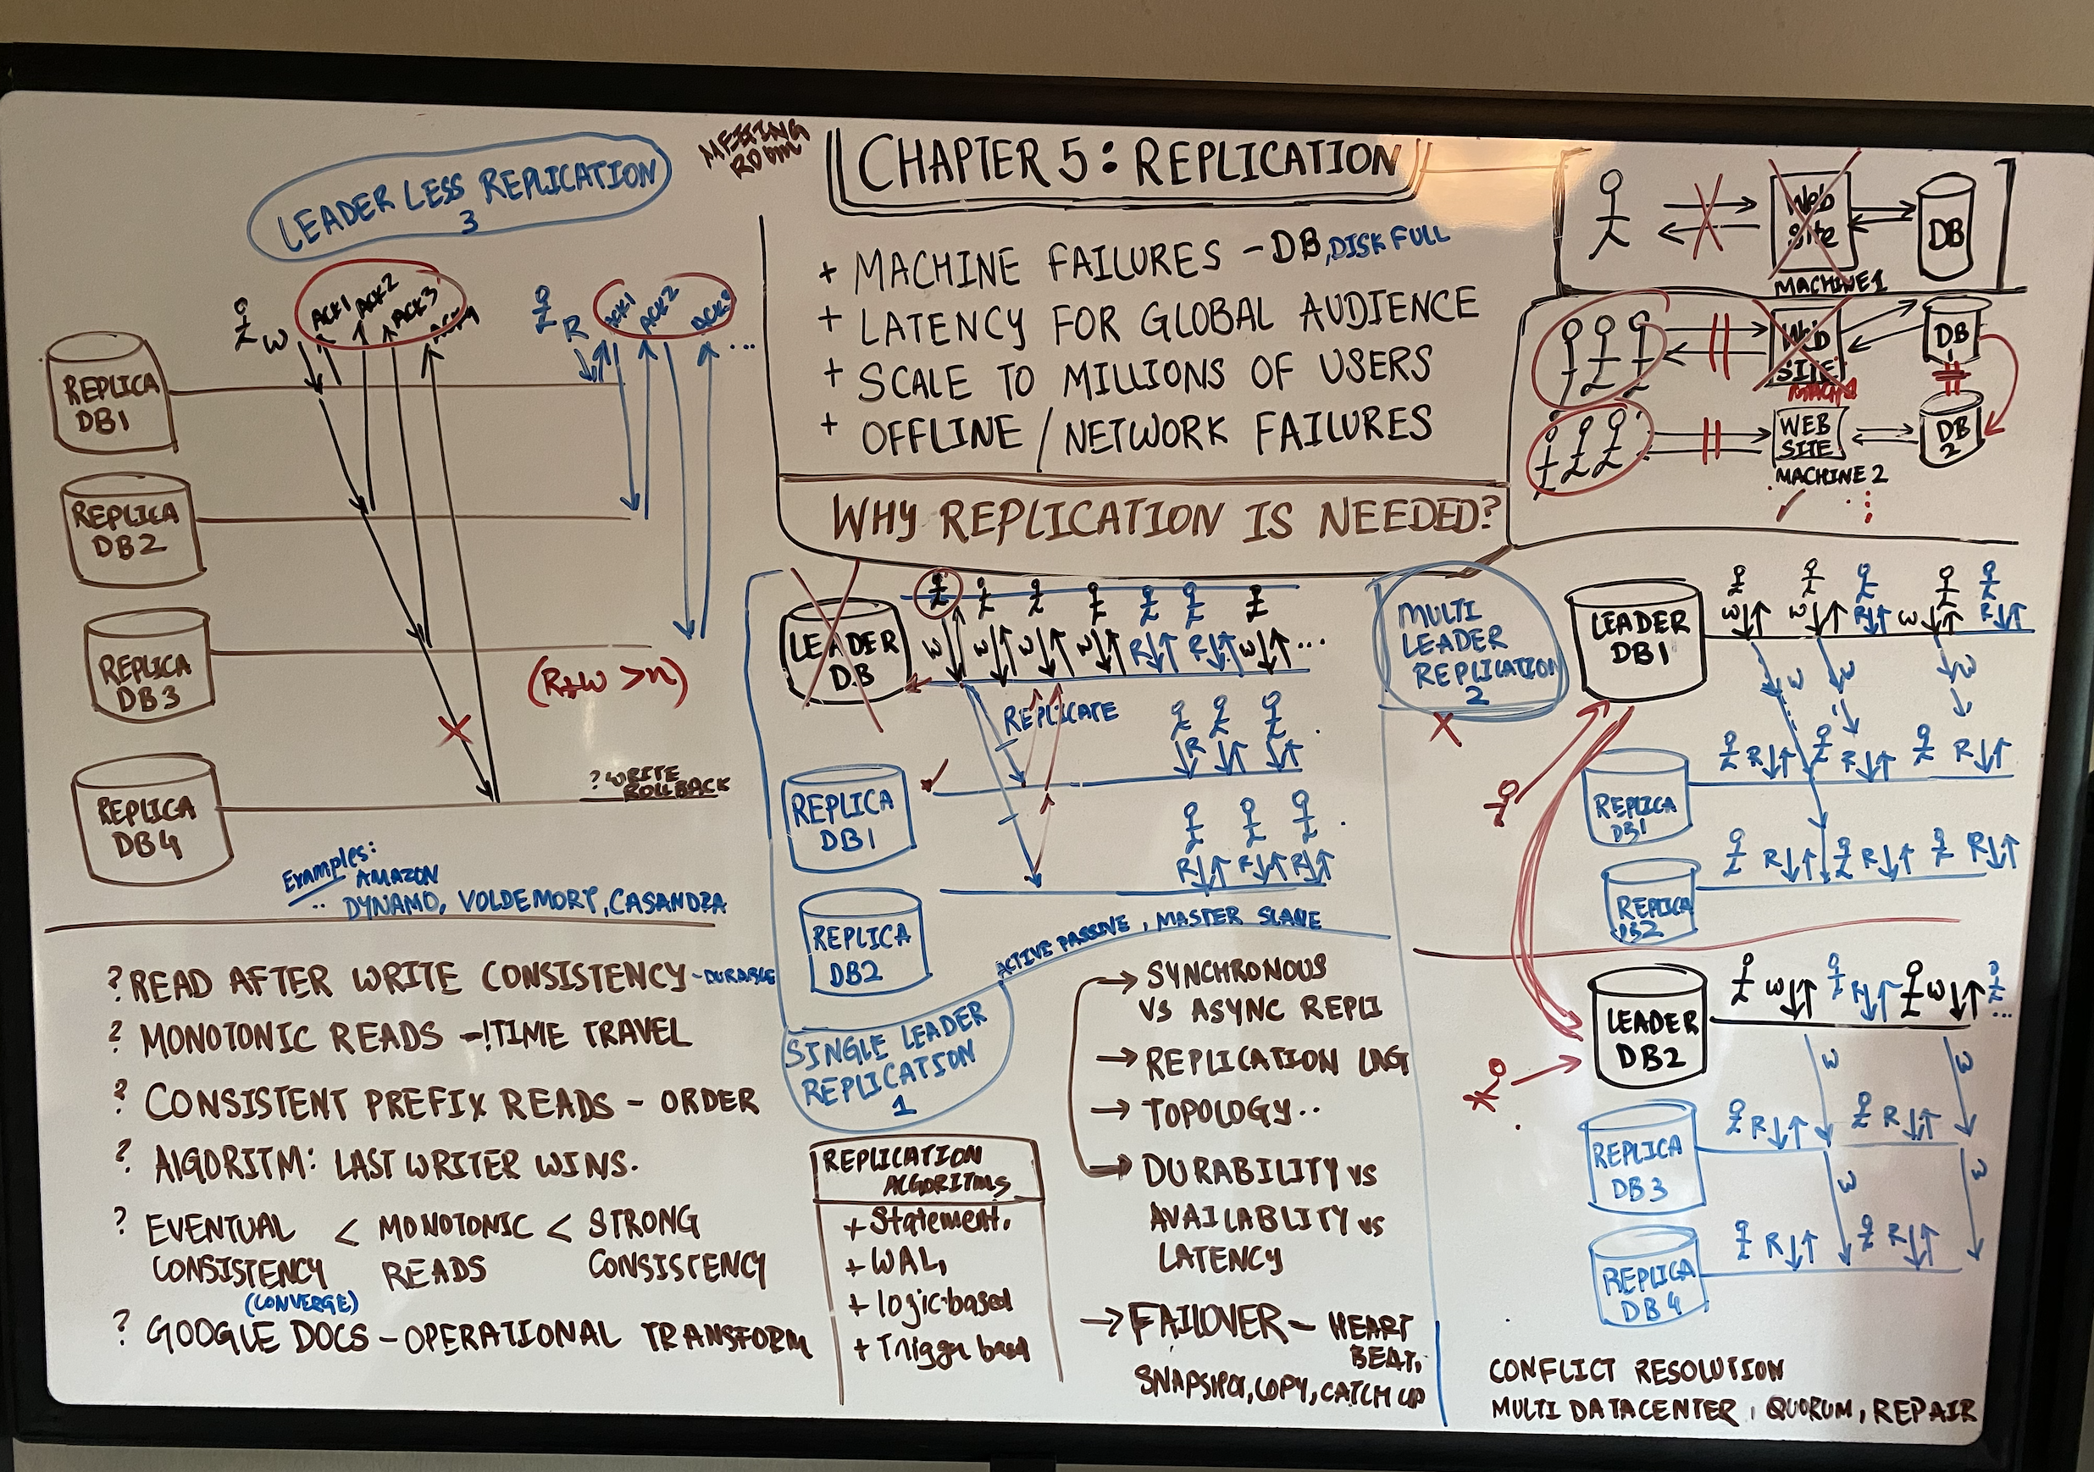

Slide 46
CHAPTER 6
PARTITIONING

Slide 47
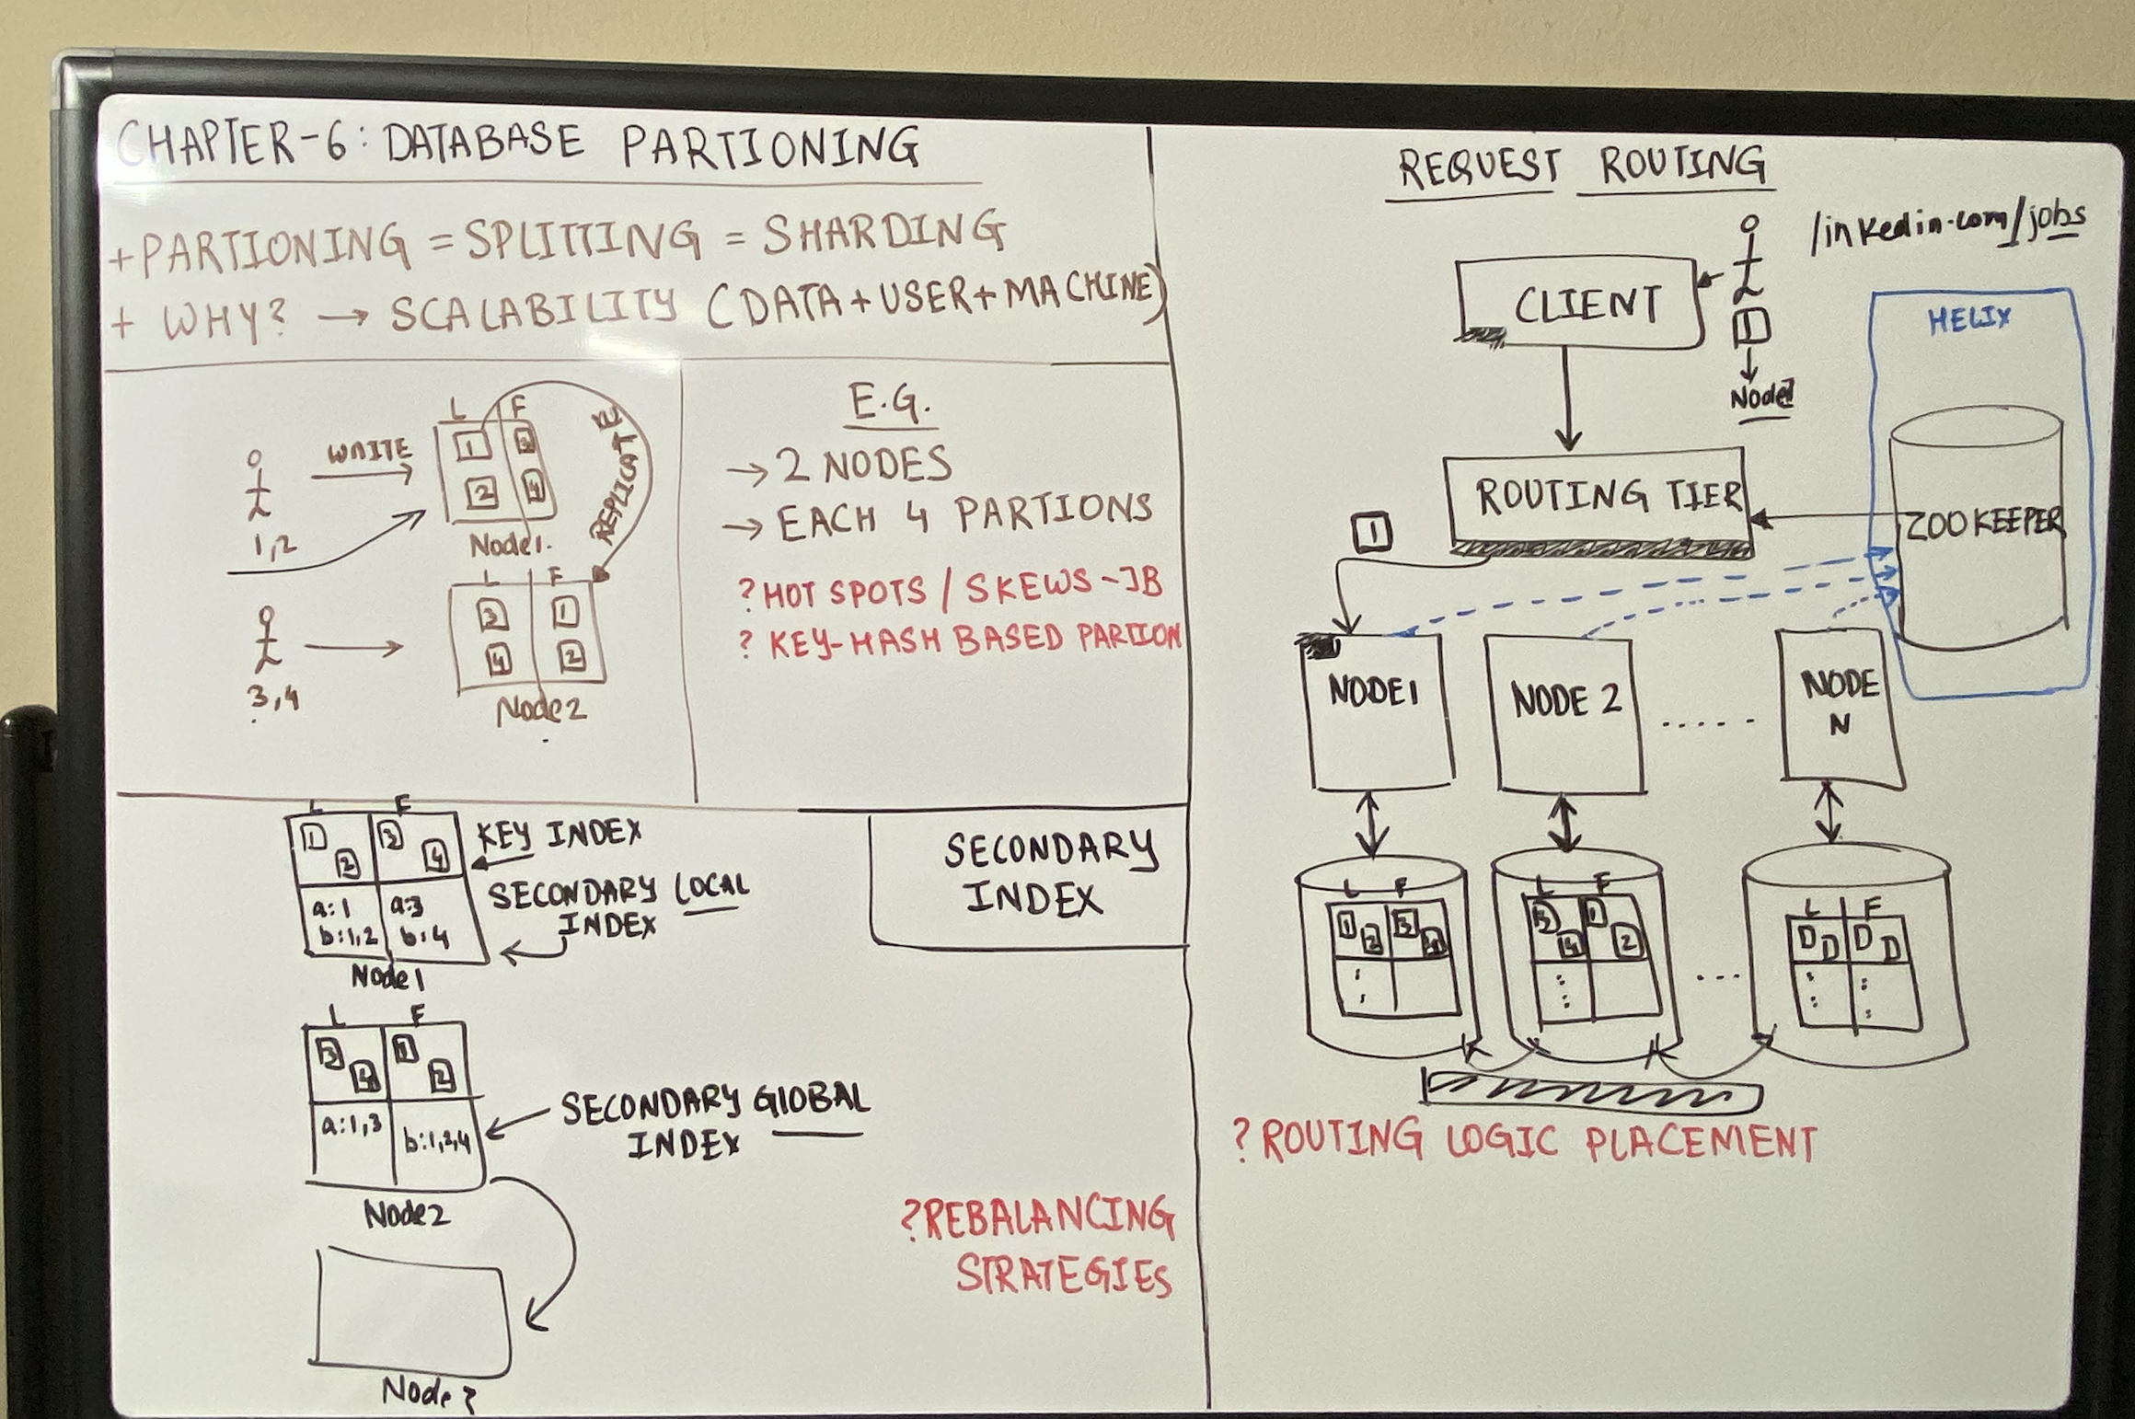

Slide 48
CHAPTER 7
TRANSACTIONS

Slide 49
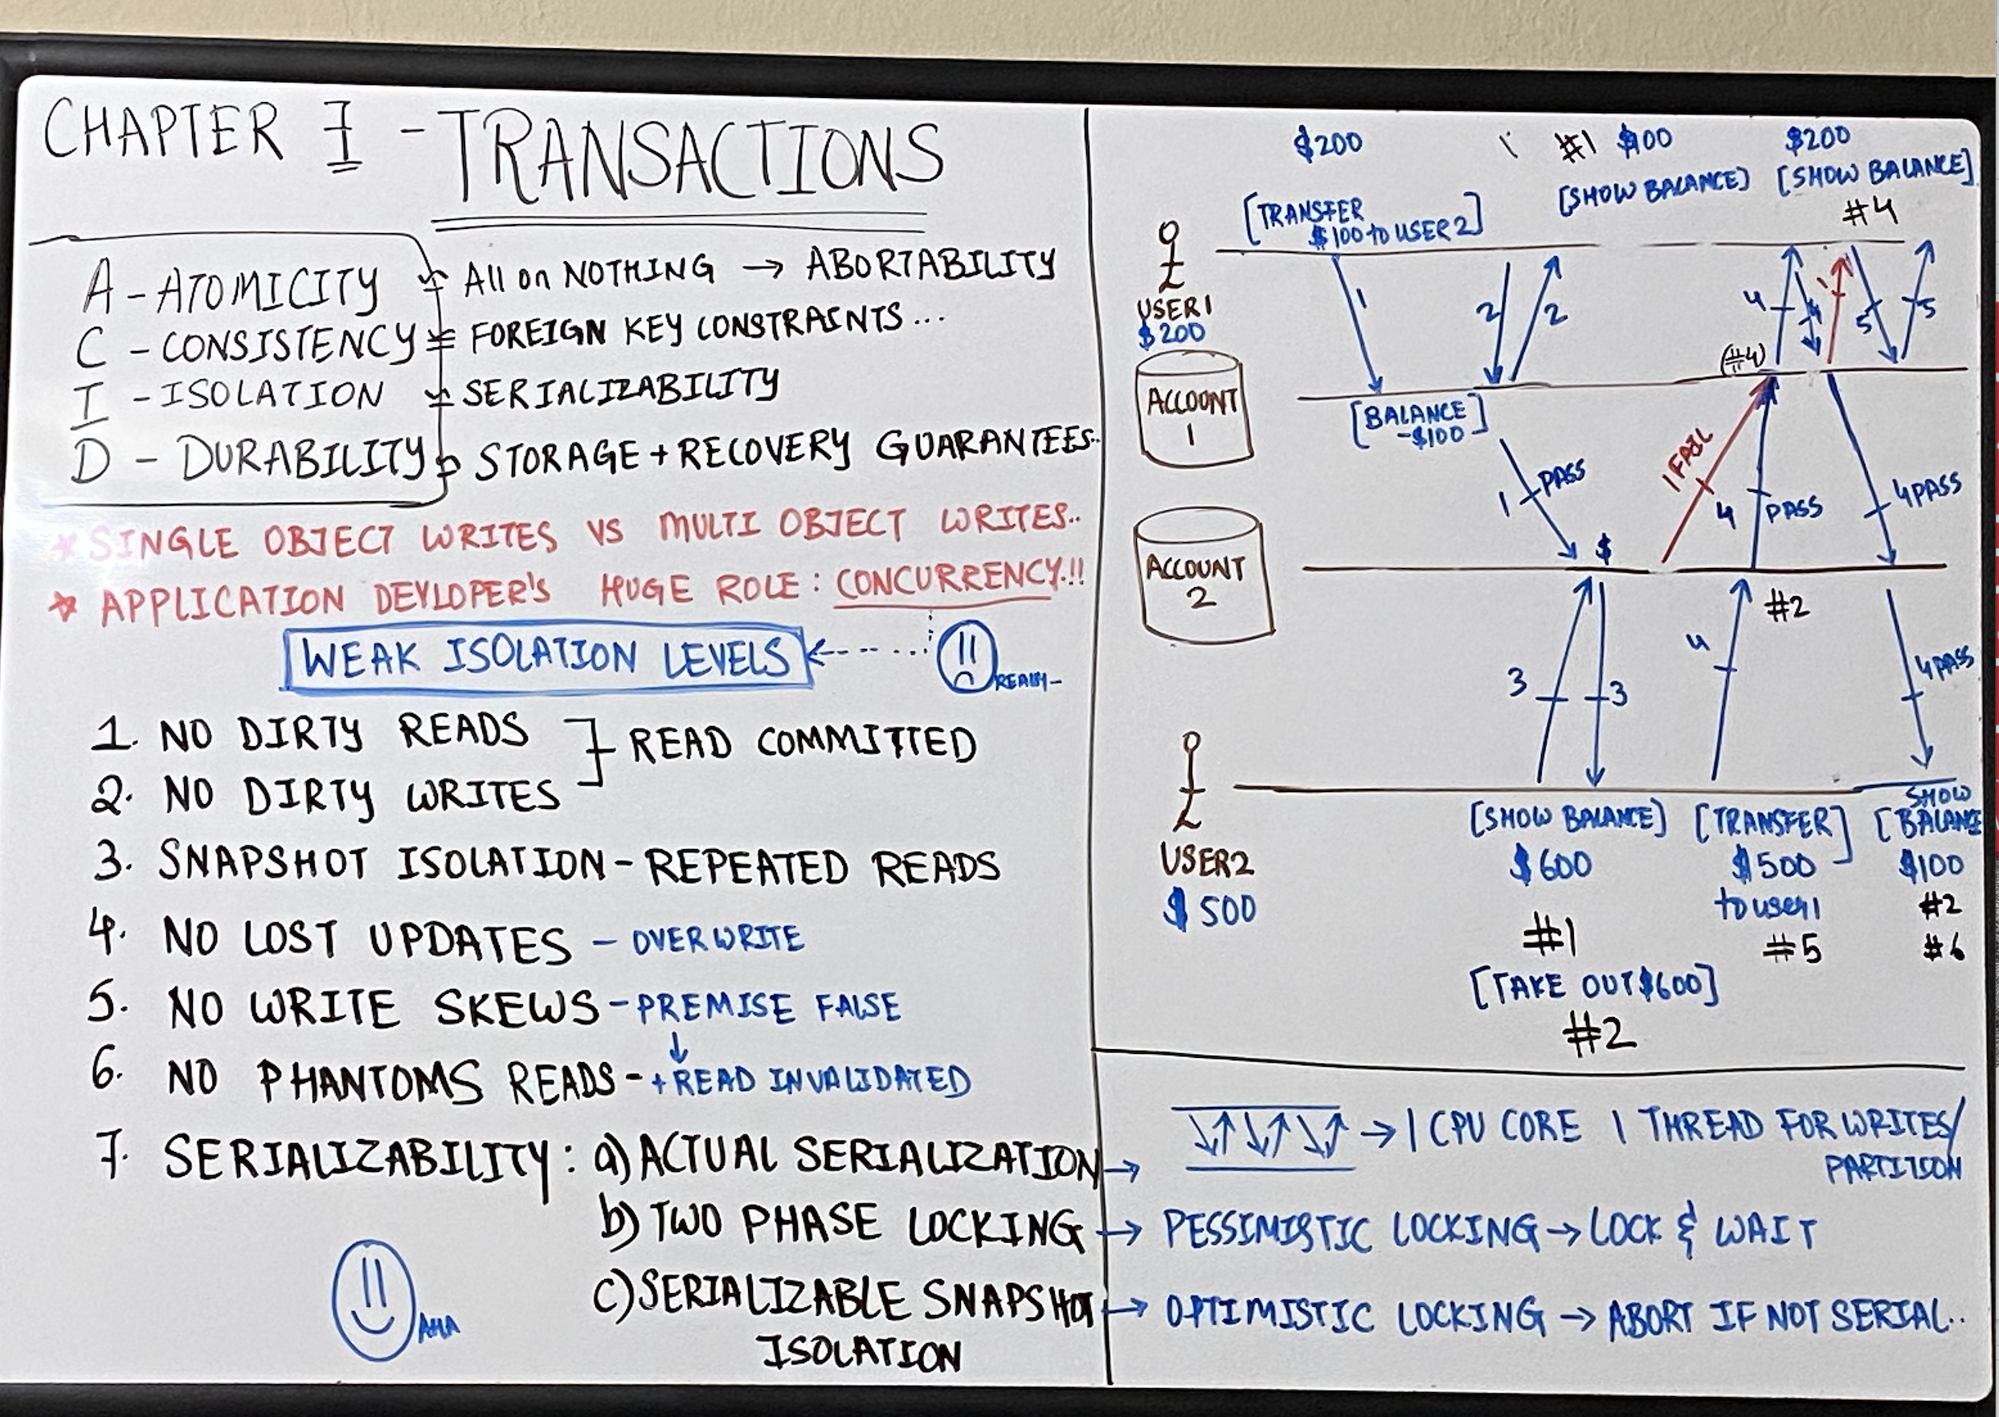

Slide 50
CHAPTER 8
Troubles with Distributed System

Slide 51
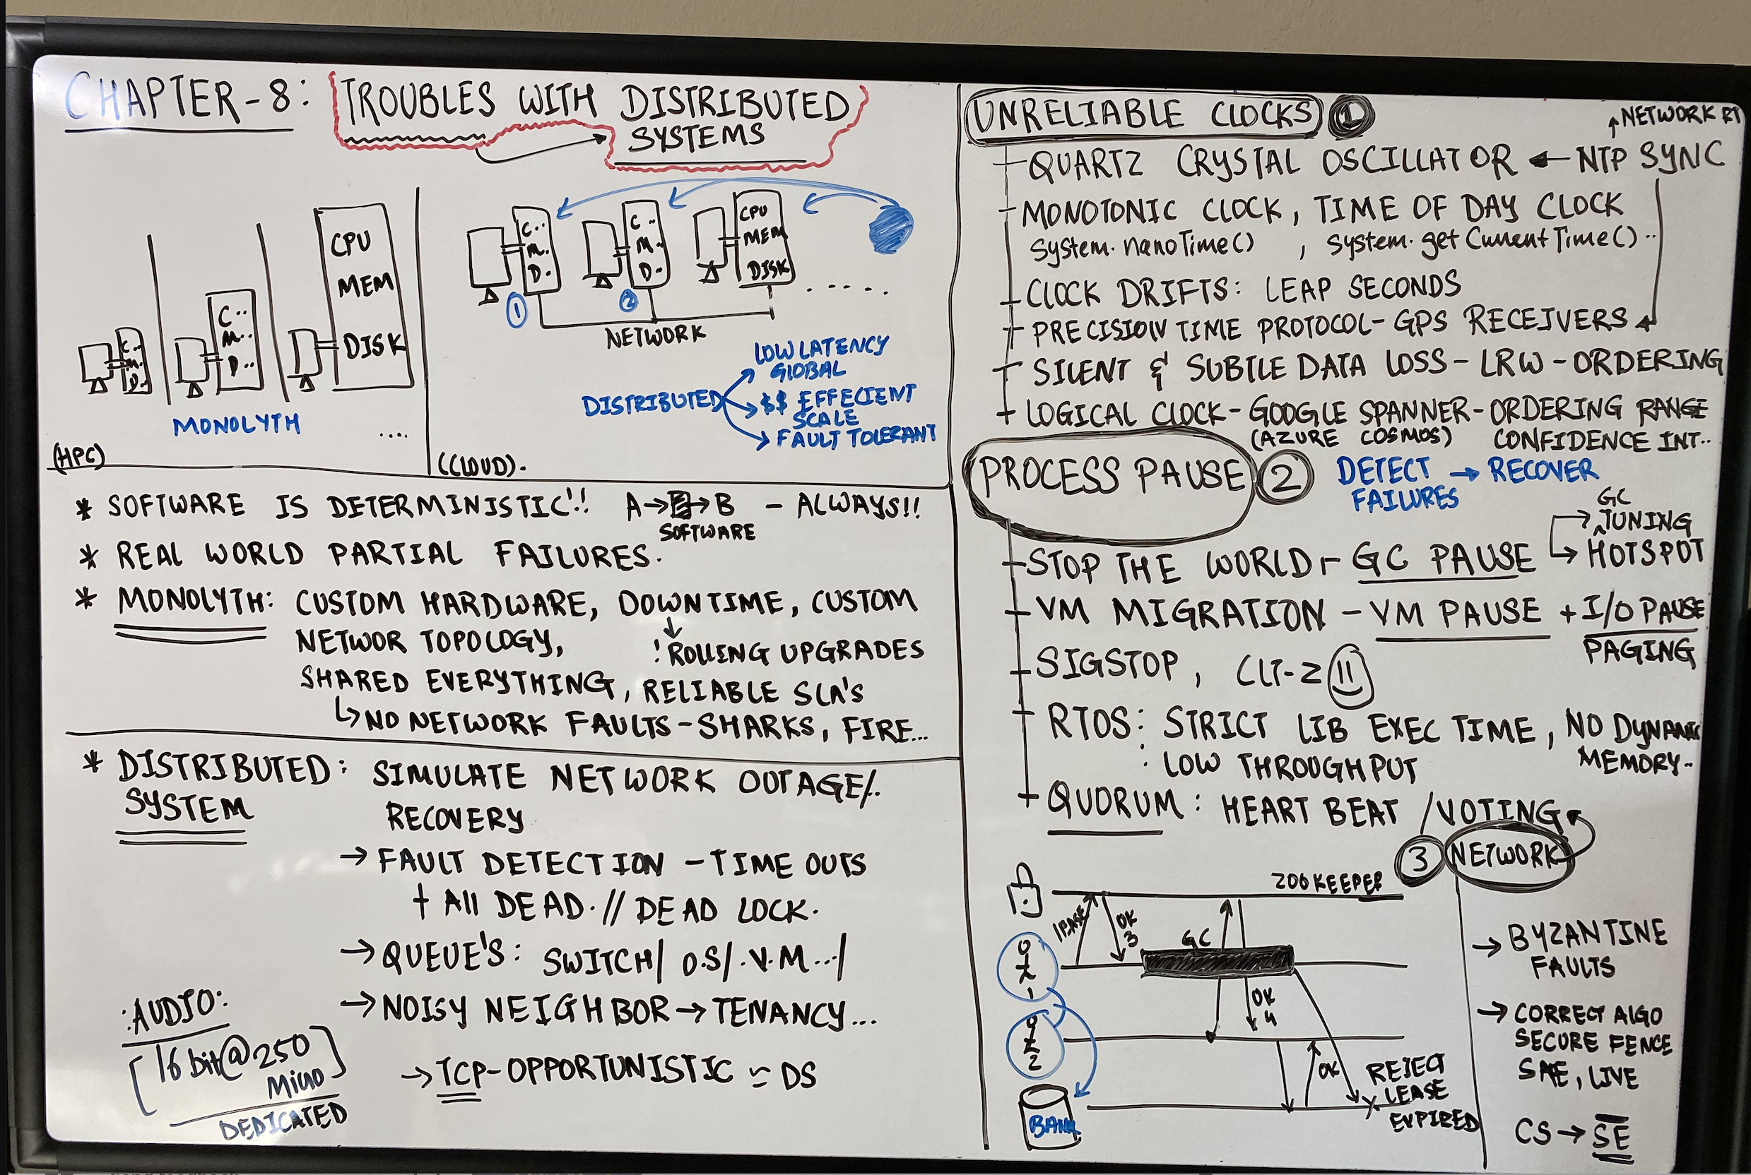

Slide 52
CHAPTER 9
CONSISTENCY& CONSENSUS

Slide 53
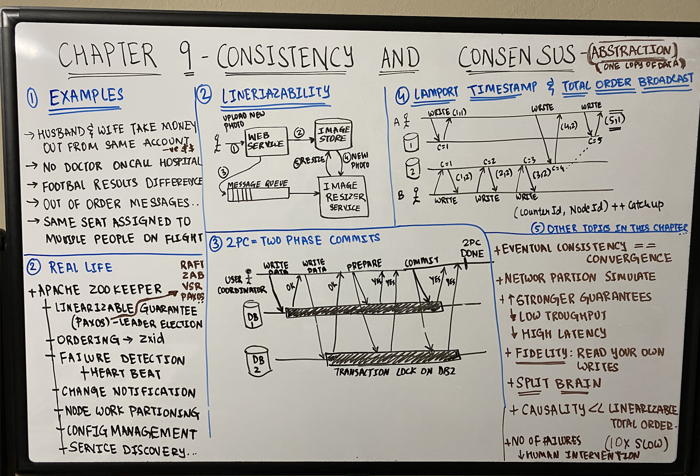

Slide 54
CHAPTER 10
BATCH
PROCESSING

Slide 55
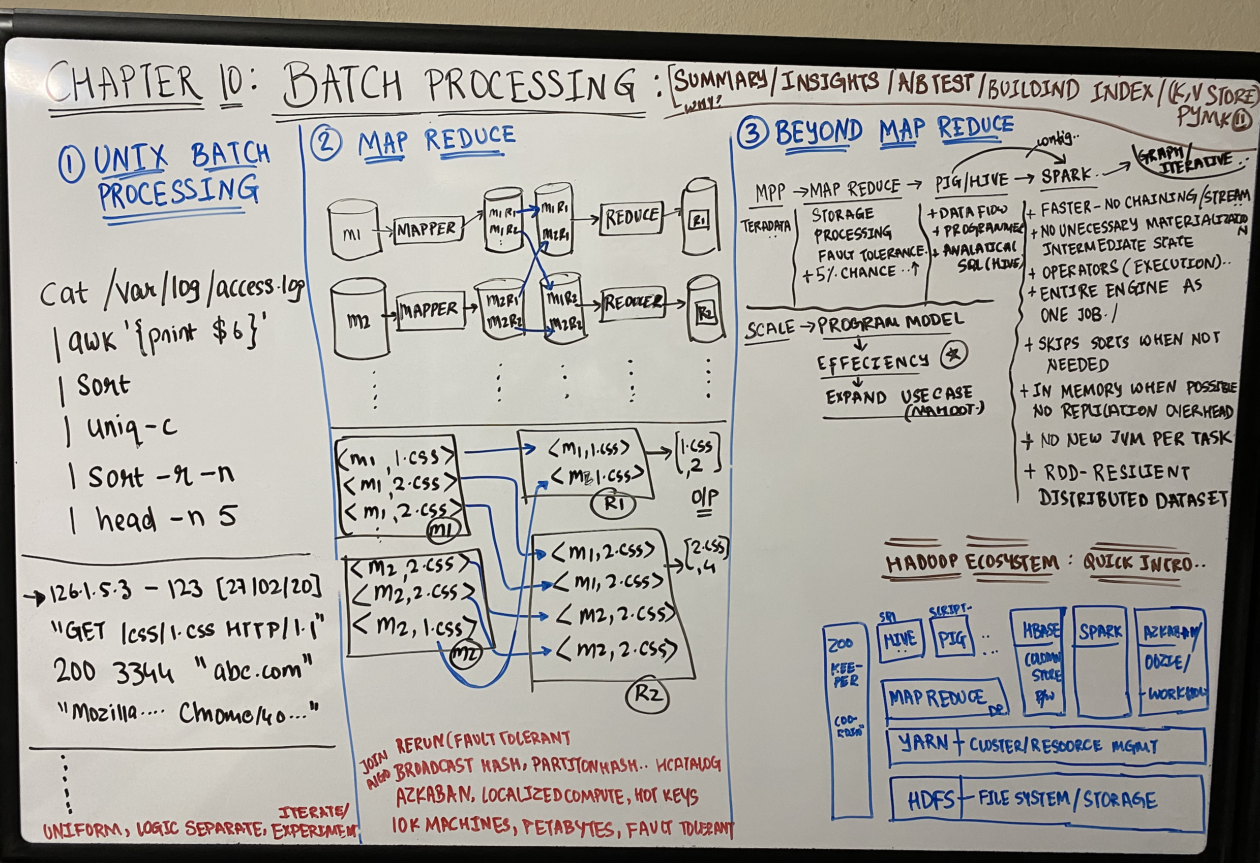

Slide 56
CHAPTER 11
STREAM
PROCESSING

Slide 57
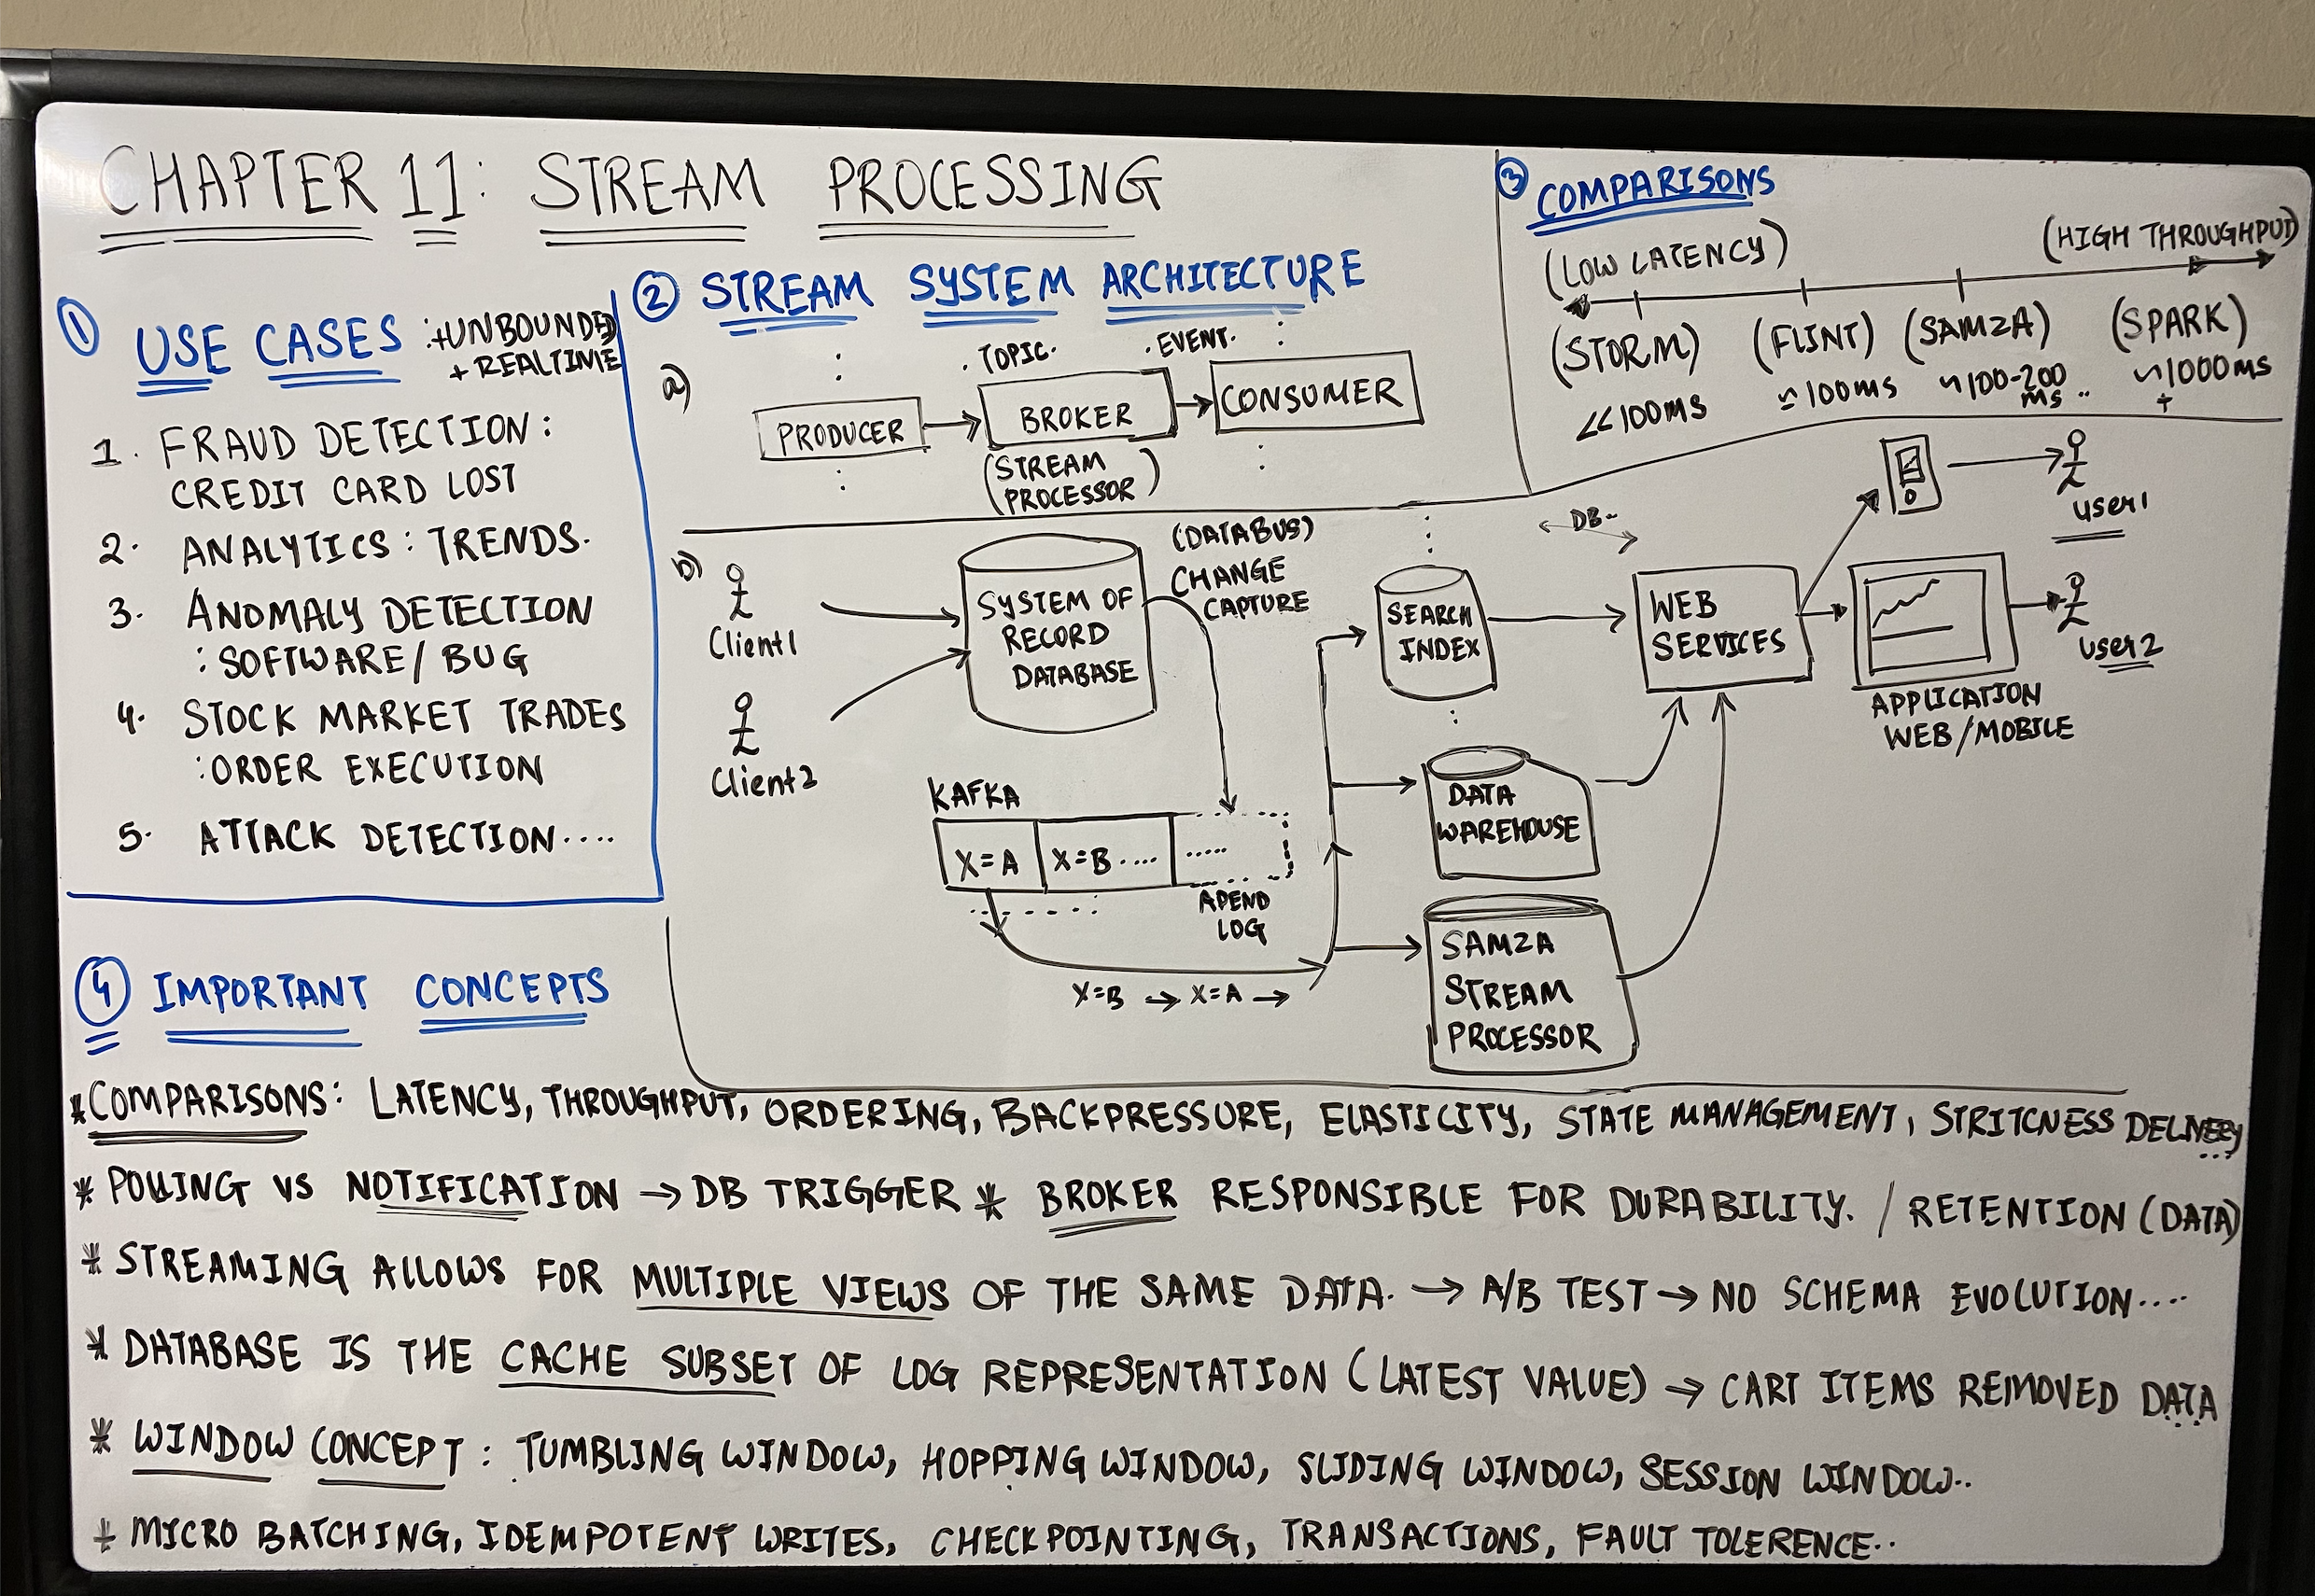

Slide 58
CHAPTER 12
FUTURE of DATA SYSTEMS

Slide 59
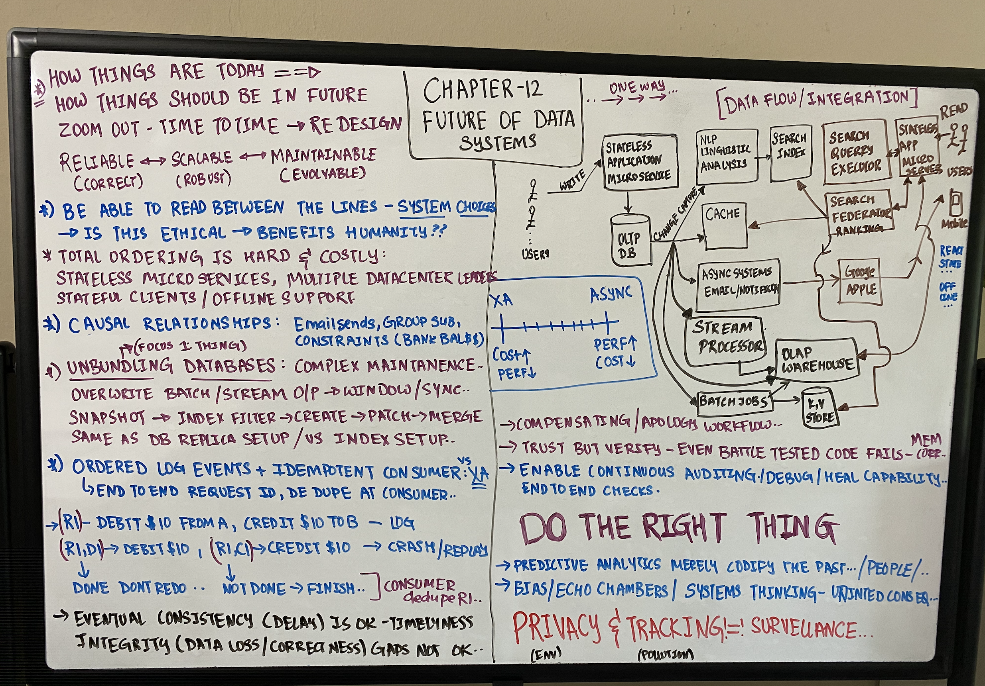

Slide 61
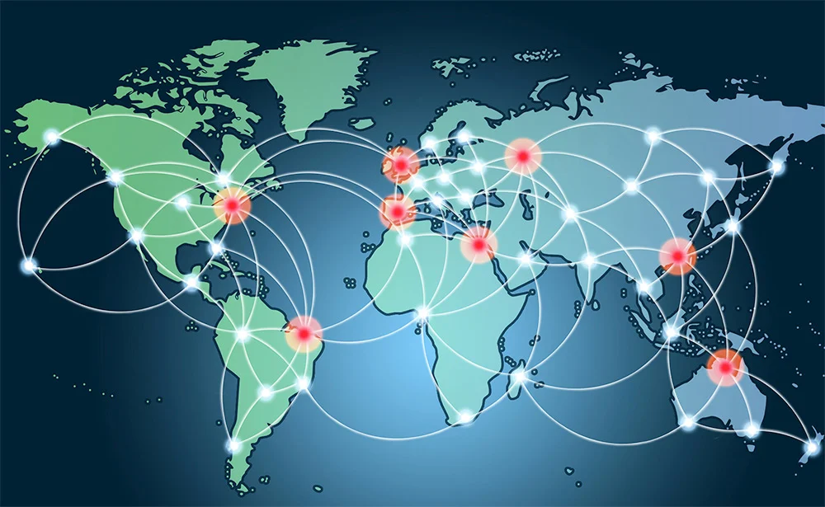
Introduction to CDN

